Slide 1

Performance Evaluation of Computer Systems and Networks
Control Tower System Analysis
Nicola Barsanti, Riccardo Bertini, Luigi Treccozzi

Slide 2
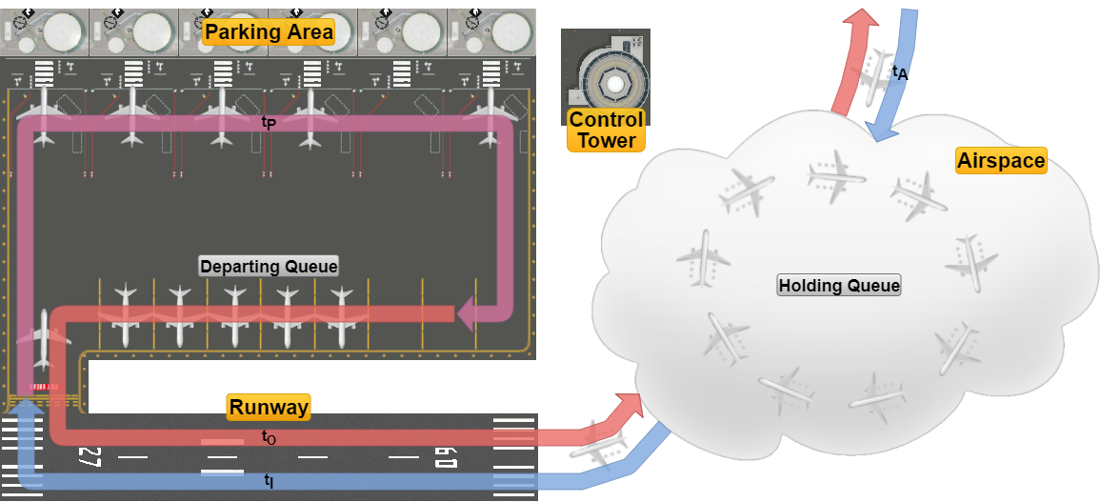
System Model

Slide 3
Working Hypotheses
1) Analyse in both deterministic and exponential regimes.
2) Airplanes waiting for landing have an infinite fuel supply.
3) The parking area has an infinite airplane capacity.
Additional Hypotheses
4) System analysis starts from its empty state.
5) t_{P} starts when leaving the runway, ends when enqueuing for take-off.
6) In case of conflicts, the airplane waiting for landing has the priority.
7) No real-world delays or other factors are taken into account.

Slide 4
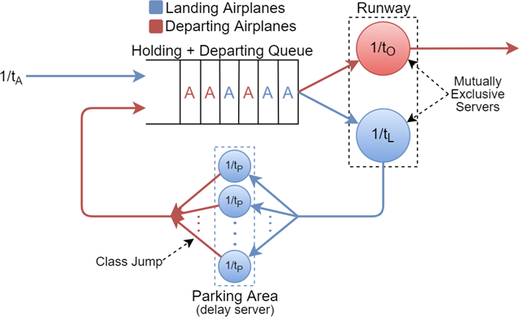
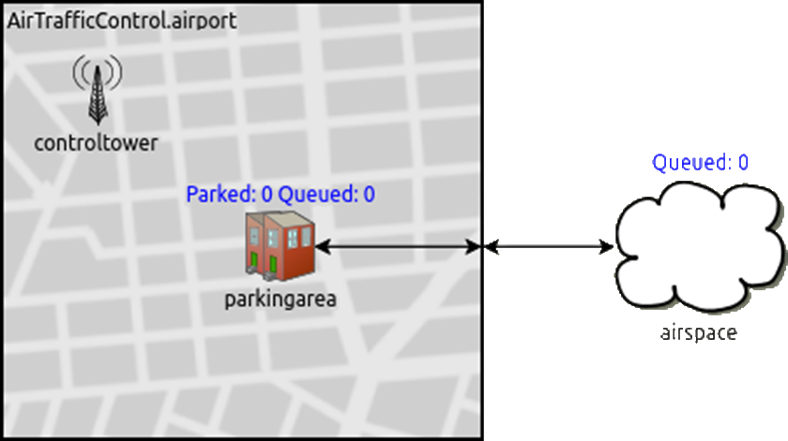
QT Equivalent Model
Simulation Model
Queues merged in a single logical queue
Control Tower has no correspondence
Steady-state equations can’t be derived
Three simple modules
The runway is a connection
Control tower is a logical module

Slide 5
System Statistics
The number of airplanes waiting in both queues (Holding Queue Size and Depart Queue Size)
The airplanes’ waiting times in both queues (Holding Queue Waiting Time and Depart Queue Waiting Time)
The number of parked airplanes (Parked Planes)
The system total response time (Airport Response Time)

Slide 6
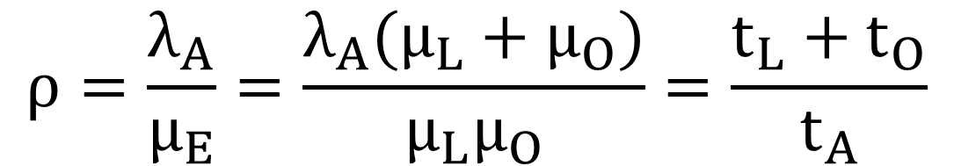
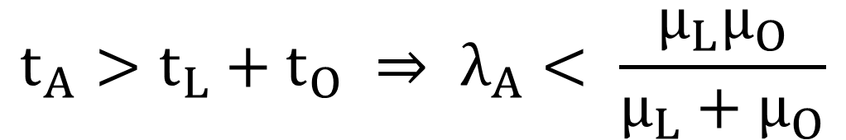
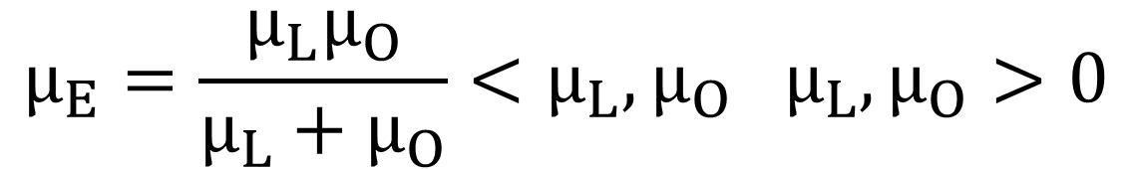
System Stability Analysis
$$t_{A}>t_{L}+t_{O} ⇒ λ_{A}< \frac{μ_{L}μ_{O}}{μ_{L}+μ_{O}}$$
Stability Condition:
$$μ_{E}=\frac{μ_{L}μ_{O}}{μ_{L}+μ_{O}}<μ_{L},μ_{O} μ_{L},μ_{O}>0$$
Equivalent Service Rate:
$$ρ=\frac{λ_{A}}{μ_{E}}=\frac{λ_{A}(μ_{L}+μ_{O})}{μ_{L}μ_{O}}=\frac{t_{L}+t_{O}}{t_{A}}$$
System Utilization Factor:

Slide 7
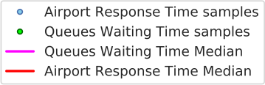
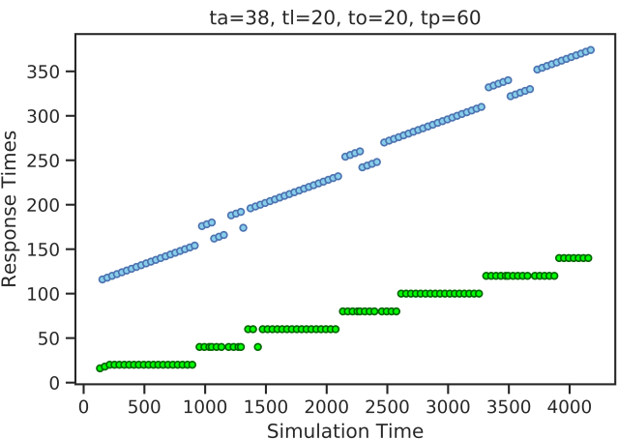
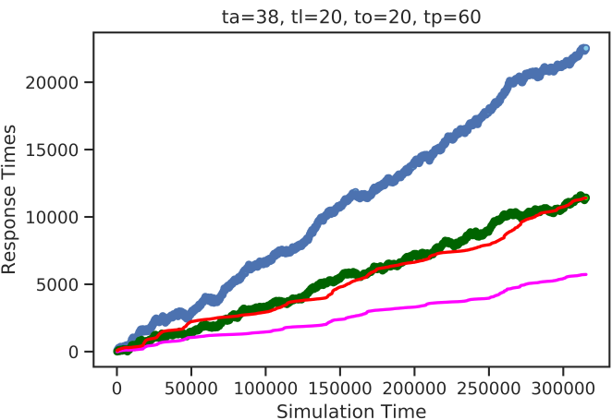
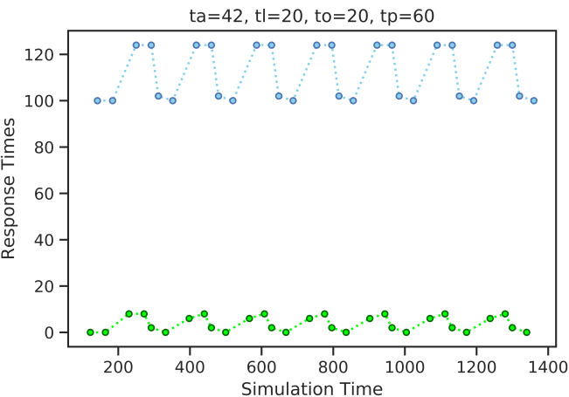
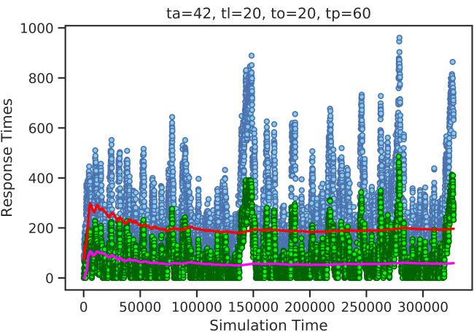
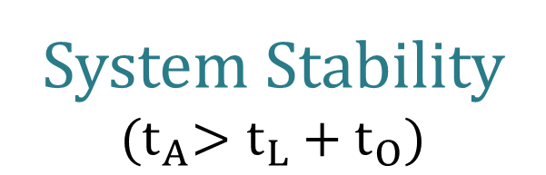
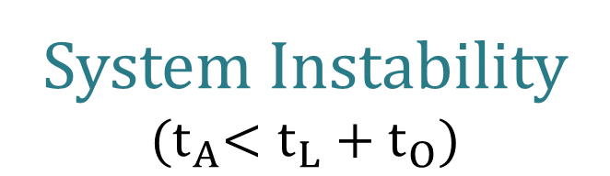
Deterministic
Exponential
System Instability $${(t}_{A}<t_{L}+t_{O})$$
System Stability $${(t}_{A}>t_{L}+t_{O})$$

Slide 8
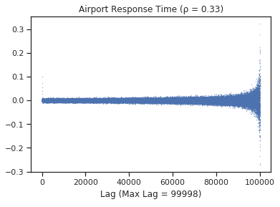
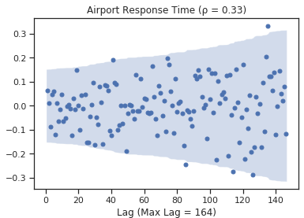
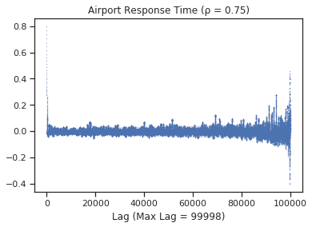
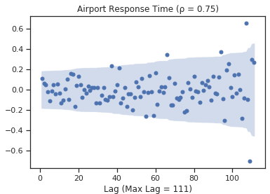
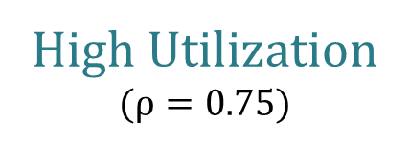
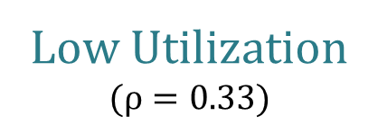
Subsampling and Confidence Levels
Statistics autocorrelation dependent on the utilization factor ρ
Before Subsampling
After Subsampling
Low Utilization $$(ρ=0.33)$$
High Utilization $$(ρ=0.75)$$
Confidence intervals taken with a confidence level of 95% (α = 0.05)

Slide 9
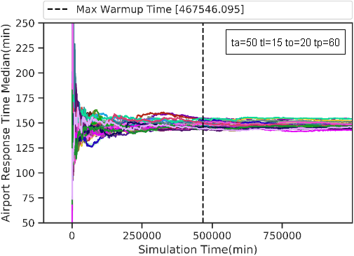


Warm-up Time Study
System warm-up time corresponds to the time required by the mean throughput of airplanes on the feedback loop (Parking Area) to stabilize.
Deterministic Warm-up Time:
$$t_{WA}=t_{A}+t_{L}+t_{P}$$
Exponential Warm-up Time: (attempt)
$$t_{WA}=k(t_{A}+t_{L}+t_{P}+t_{O})$$
Exponential Warm-up Time: (rigorous method)

Slide 10
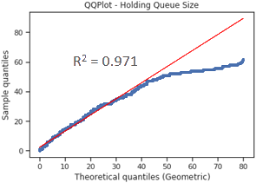
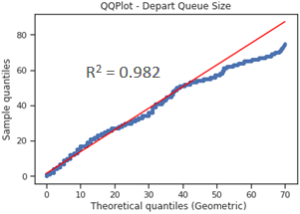
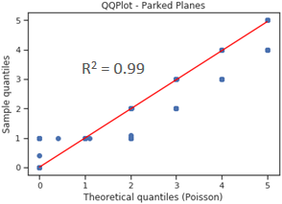
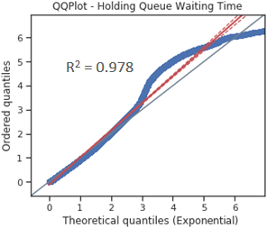
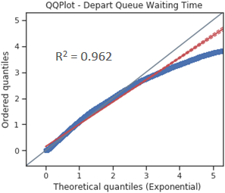
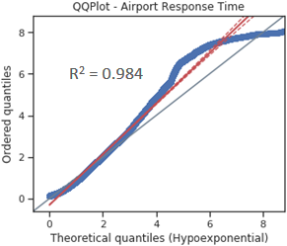
Statistics Distributions Fitting

Slide 11
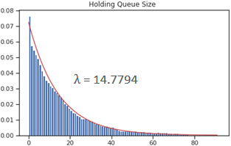
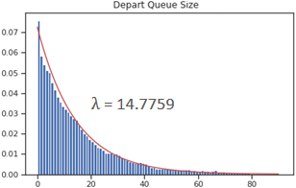
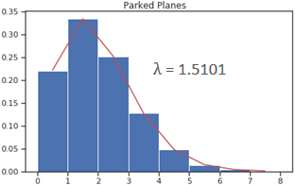
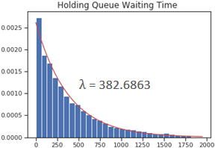
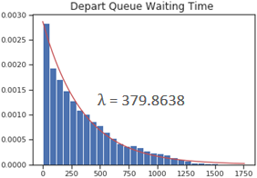
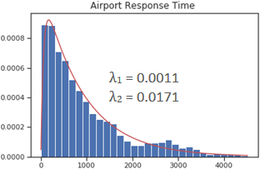
Maximum Likelihood Estimators
Both queues share the same distributions with the same parameters

Slide 12
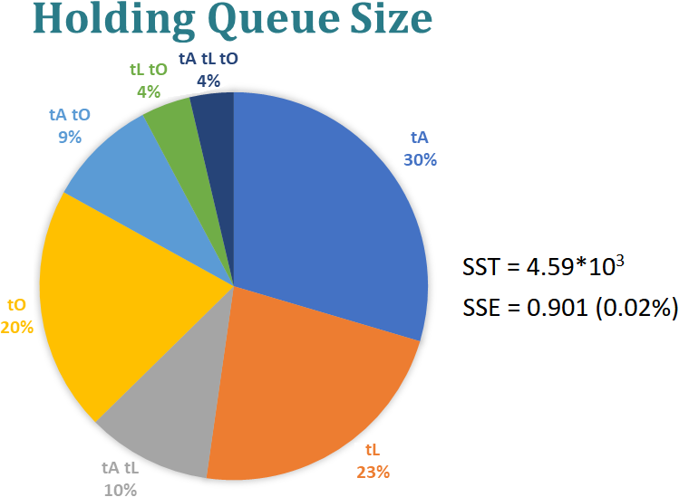
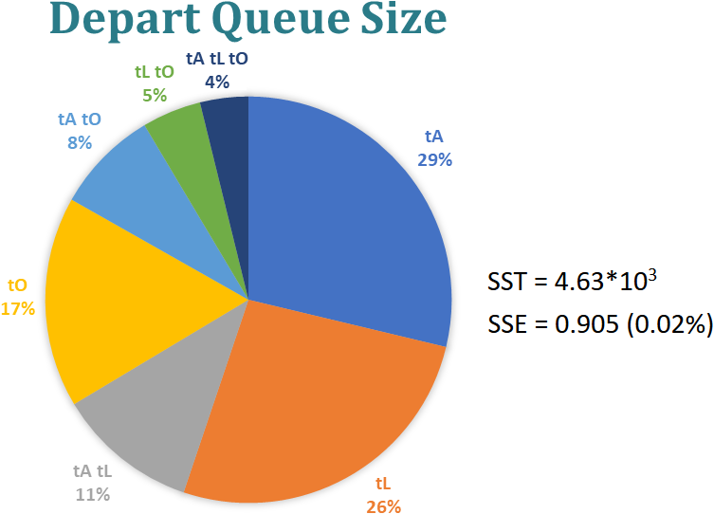
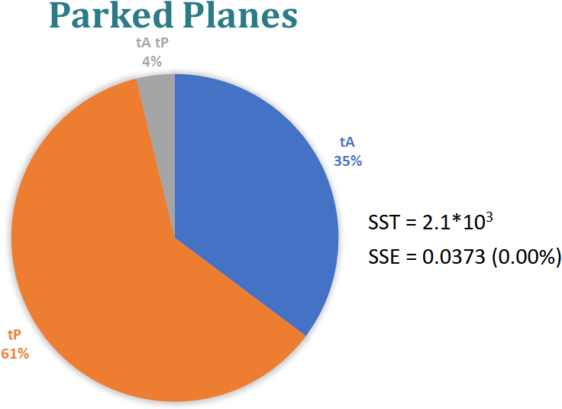
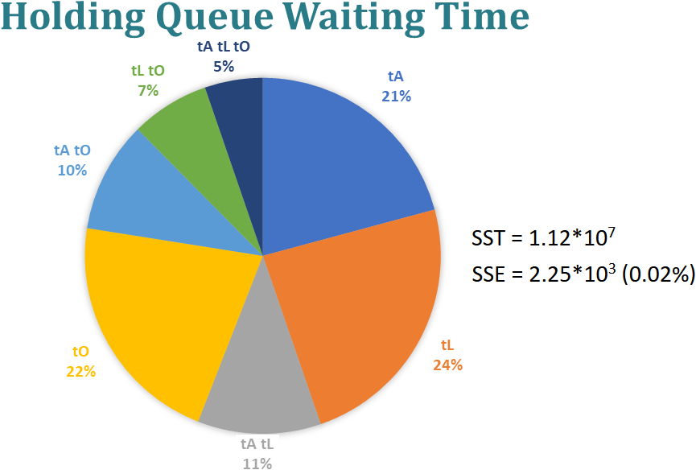

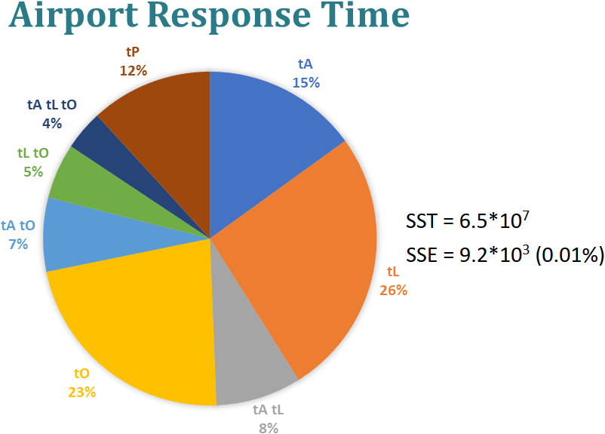
2^{k}r Factorial Analysis

Slide 13
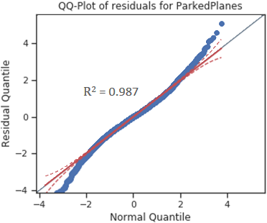
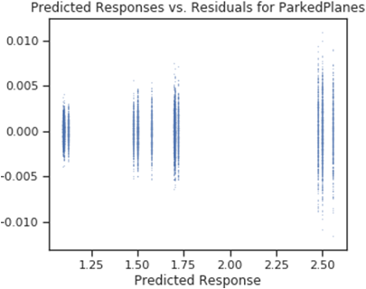
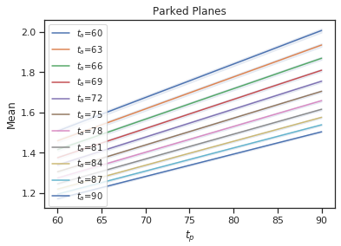
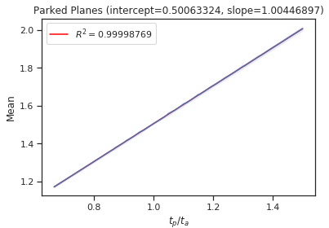
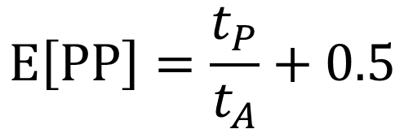
CI on the results can be computed for the Parked Planes only
Parked Planes Analysis:
$$E\left[PP\right]=\frac{t_{P}}{t_{A}}+0.5$$

Slide 14
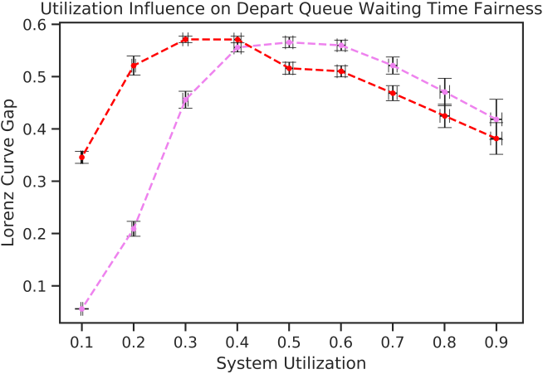
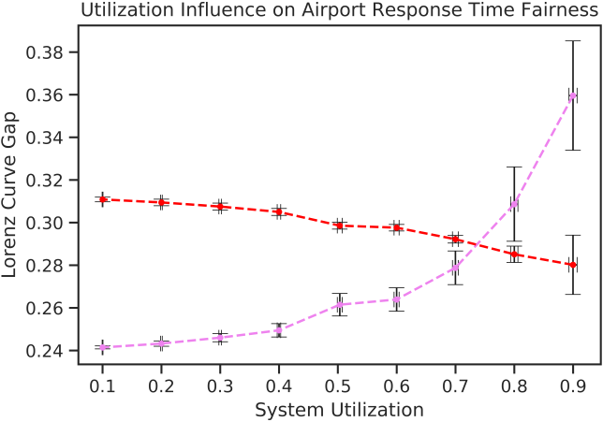

System Fairness Analysis
Fairness mainly influenced by three factors:
System Utilization Factor ρ.
Parking Time t_{P}, which decouples the two queues.
Number, weights and likeliness of the influencing parameters (CLT).
Queue Waiting Time Fairness
Airport Response Time Fairness
The two fairnesses are not directly related

Slide 15
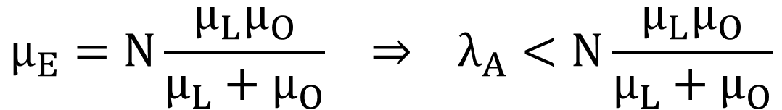
Concluding Remarks
The analysed system is unfair by nature, with trends alternating in time spikes of high and dips of low values, a behaviour that can be mainly attributed to the mutually exclusive utilization of a single shared resource (the runway) by the two queues.
Performance-increasing Proposals
Introduce additional runways, which allows for a linear scaling of the system’s equivalent service rate:
$$μ_{E}=N\frac{μ_{L}μ_{O}}{μ_{L}+μ_{O}} ⇒ λ_{A}<N\frac{μ_{L}μ_{O}}{μ_{L}+μ_{O}}$$
N = Number of Runways
In a real-world scenario, all necessary measures should be taken in order to limit as much as possible the randomness of the system (e.g. by scheduling flights and enforcing strict time protocols within the airport).

